Slide 1
A/B Testing: Does Showing Users an Advertisement Instead of a Public Service Announcement Increase Conversion?
George Chadwick-Jones
Measuring conversion impact through hypothesis testing and supportive EDA.

Slide 2
Business Question and Objective
The business wants to determine whether showing users an advertisement as opposed to a public service announcement (PSA) leads to more product conversions.
This analysis compares users in two groups: those who are shown the advertisement (treatment group) and those who have seen the PSA (control group).
The primary objective of this project is to determine whether the observed difference in conversion rate between the two groups has statistical significance, providing evidence that can support the business’s decision about what type of content to show users.
The analysis also includes secondary EDA of user behaviour, exploring how conversion rate varies with metrics such as the number of ads seen or the time of day that most ads were viewed by a user. These additional associations provide context around when and how users interact with the advertisements.

Slide 3
Hypothesis and Statistical Approach
To determine whether the observed difference between the treatment group (ads) and control group (PSA) was significant, a two-proportion z-test was used as the outcome is binary and we are comparing proportions.
The null hypothesis (H₀) assumes that there is no difference in conversion rate between the two groups, whereas the alternative hypothesis (H₁) assumes that the conversion rates are different.
A significance level of α = 0.05 was used.
The analysis was completed by 95% confidence intervals.

Slide 4
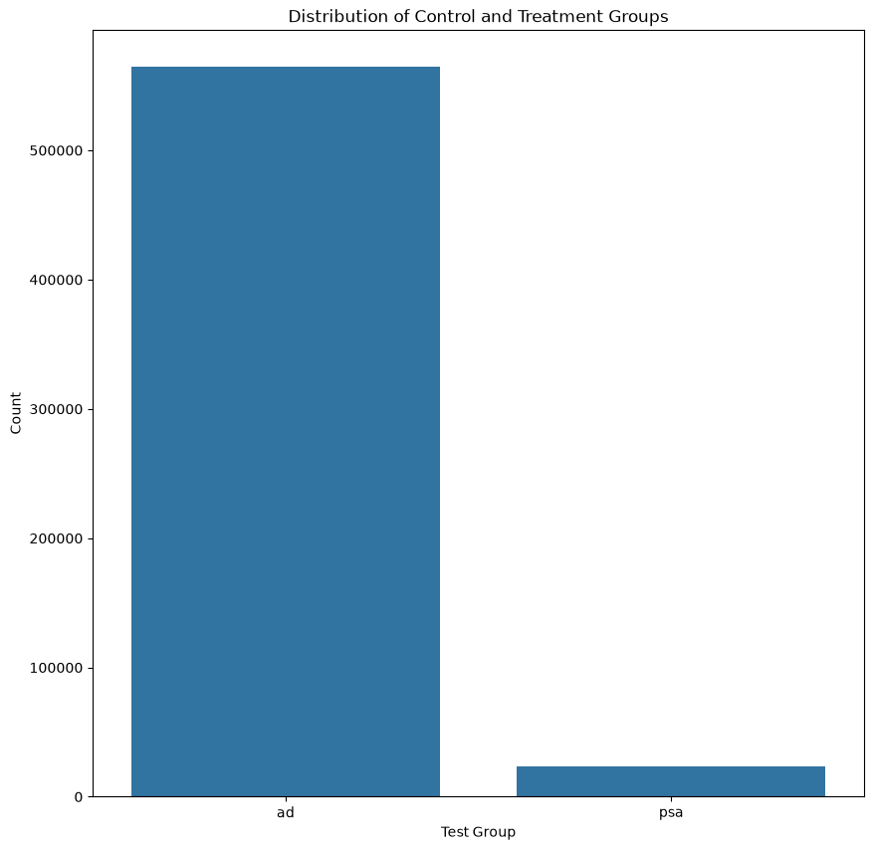
Data Set and Experiment Groups
The dataset contains 588,101 users, with each observation representing an individual users and how they have interacted with the campaign. The dataset contains information on the user’s experimental group, whether they converted, the total number of ads they viewed as well as the day and hour that each user viewed the most advertisements.
Initial data checks found no null values or duplicated observations, and each user was unique.
The experimental groups were highly imbalanced, with the treatment group (ads) having 564,577 (96%) users and the control group (PSA) 23,524 (4%) users. Although this imbalance is substantial, the control group still contains enough observations to conduct statistical analysis.

Slide 5
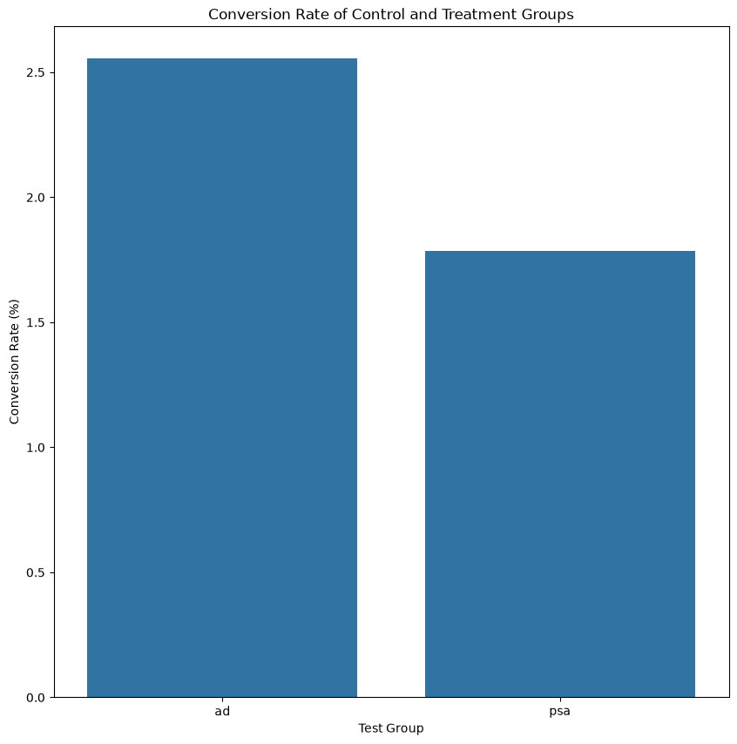
Conversion Rate Results
The first comparison of the experimental groups shows a clear difference in the conversion rates.
There is a 0.77 percentage points difference in conversion rates between users that were shown an advertisement (2.55%) compared with those who had only seen the PSA (1.79%).
The results give initial evidence that viewing the advertisement results in a higher chance of the user converting. However, it is not clear whether this result is a consequence of normal variations in the data or if it has statistical significance, so a hypothesis test is required to see if there is a genuine difference between the two groups.

Slide 6
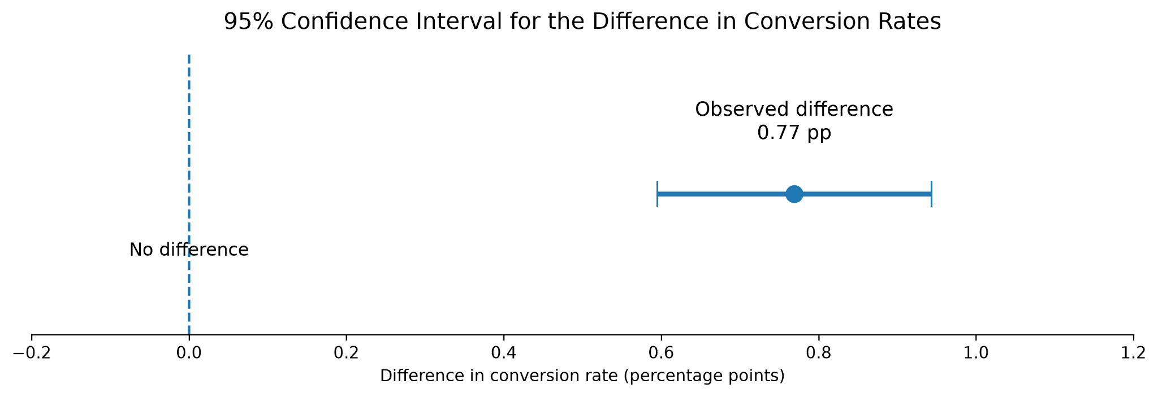
Statistical Significance
The hypothesis test provided strong statistical evidence that the conversion rates differ between the treatment group (ads) and the control group (PSA).
The test produced a z-statistic of 7.37 and a p-value of 1.71x10⁻¹³, which is far, far below the significance threshold of 0.05. We can therefore reject the null hypothesis.
The 95% confidence interval is 0.60 to 0.94 percentage points. As the results are entirely above 0, they consistently indicate a higher conversion across the treatment group.
The hypothesis test therefore proves that the results are statistically significant as opposed to being from random variation alone.

Slide 7
Effect Size and Business Significance
Although the hypothesis testing showed a clear statistical difference between the two groups, it is important to also consider that difference from a business perspective.
The advertisement group achieved a 2.55% conversion rate, compared with 1.79% for the PSA group. This represents an absolute increase of 0.77 percentage points, equivalent to a 43.1% relative lift in conversion.
The relative lift shows that the proportionally speaking the advertisement group performed significantly better than the PSA group. However, it is important to think of this difference in real-terms. The absolute increase is less than 1 additional conversion per 100 users, so the practical value depends on factors such as individual purchase cost, the cost of the campaign as well as the size of the customer base.

Slide 8
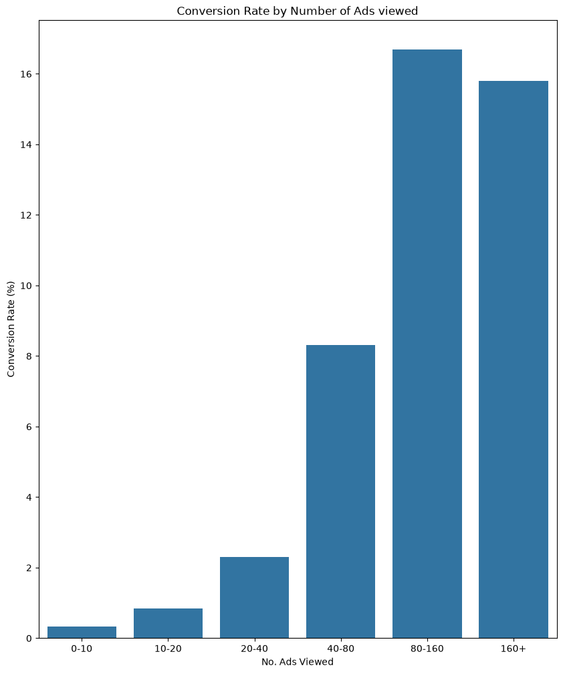
Secondary Analysis: Advertisement Exposure
The first part of the secondary supportive analysis focussed on whether conversion rates varied based on the number of advertisements that a user has been exposed to.
There was a clear positive association between the number of advertisements a user viewed and their chance of converting. Conversion increased from 0.33% among users who saw 0–10 advertisements to 16.68% among users who saw 80–160 advertisements. The 160+ group showed a slight decline to 15.79%, but this is still well above the conversion rate of those who had seen relatively fewer advertisements.
However, these results are observational only and cannot be used to imply causation. There are also confounding variables such as users who are already likely to convert may have been more likely to view and engage with the advertisement.

Slide 9
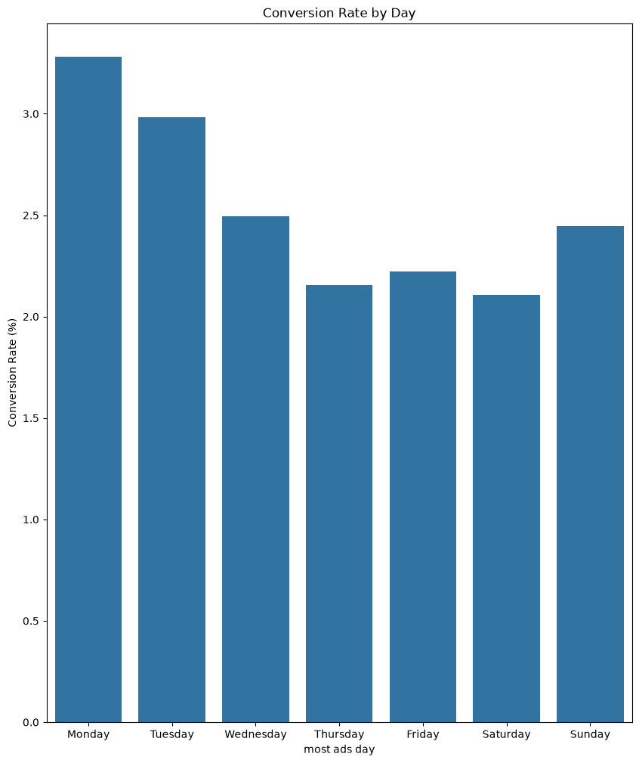
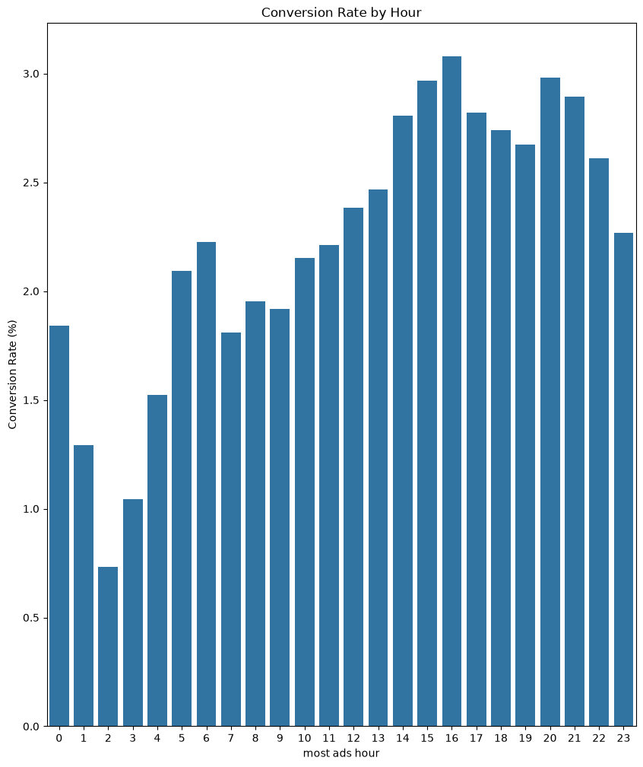
Secondary Analysis: Timing Patterns
The secondary analysis also examined whether conversion rates differed based on both the time of day and day of the week that users engaged with the most advertisements.
Conversion rates showed some fluctuation across the days of the week, with Monday recording the highest conversion rate at 3.28%, and Saturday recording the lowest at 2.11%.
There was also noticeable variation across the hours of the day, ranging from 0.73% at 02:00 to 3.08% at 16:00.
These associations give useful context around user behaviour, but the differences were not individually tested for statistical significance so they should not be treated as causation.

Slide 10
Limitations
The experimental groups were highly imbalanced, with 96% of the users in the advertisement group and only 4% in the PSA group.
The dataset does not provide information on group assignment. The result can therefore only be interpreted as being causal if the original experient genuinely used random assignment.
The supporting secondary analysis is observational and does not establish causation.

